Slide 1

















. . . . . . . . . . . . . . . . . . . . .
. . . . . . . . . .
. . . . . . . . . . . . . . . . . . . . .
. . . . . . . . . .
. . . . . . . . . . . . . . . . . . . . .
. . . . . . . . . .
. . . . . . . . . . . . . . . . . . . . .
. . . . . . . . . .
. . . . . . . . . . . . . . . . . . . . .
. . . . . . . . . .
Transcript Generation
System
Transcript Generation
System
Transcript Generation
System
. . . . . . . . . . . . . . . . . . . . .
. . . . . . . . . .
. . . . . . . . . . . . . . . . . . . . .
. . . . . . . . . .
. . . . . . . . . . . . . . . . . . . . .
. . . . . . . . . .
. . . . . . . . . . . . . . . . . . . . .
. . . . . . . . . .
. . . . . . . . . . . . . . . . . . . . .
. . . . . . . . . .
. . . . . . . . . . . . . . . . . . . . .
. . . . . . . . . .
. . . . . . . . . . . . . . . . . . . . .
. . . . . . . . . .
. . . . . . . . . . . . . . . . . . . . .
. . . . . . . . . .
CMPE 30052 Lab Project
. . . . . . . . . . . . . . . . . . . . .
. . . . . . . . . .
. . . . . . . . . . . . . . . . . . . . .
. . . . . . . . . .
. . . . . . . . . . . . . . . . . . . . .
. . . . . . . . . .
. . . . . . . . . . . . . . . . . . . . .
. . . . . . . . . .
. . . . . . . . . . . . . . . . . . . . .
. . . . . . . . . .
. . . . . . . . . . . . . . . . . . . . .
. . . . . . . . . .

Slide 2




. . . . . . . . . . . . . . . . . . . . .
. . . . . . . . . .
Project description
. . . . . . . . . . . . . . . . . . . . .
. . . . . . . . . .
. . . . . . . . . . . . . . . . . . . . .
. . . . . . . . . .
. . . . . . . . . . . . . . . . . . . . .
. . . . . . . . . .
The program starts by asking the user to select the student level:
Undergraduate (U) or Graduate (G) option or Both (B) options.
Also, under the G and B options, the user will be asked again for:
Master (M) or Doctorate (D) or Both (B0).
Once the user selects the option(s), it asks him for the student ID (stdID) (i.e. 202006000).
Then, the program will redirect you to the menu options by calling the menu feature function.
Note that,If the user enters wrong ID, the program will keep asking him for the correct student ID based on the available ID’s in the database.
. . . . . . . . . . . . . . . . . . . . .
. . . . . . . . . .
. . . . . . . . . . . . . . . . . . . . .
. . . . . . . . . .
. . . . . . . . . . . . . . . . . . . . .
. . . . . . . . . .
. . . . . . . . . . . . . . . . . . . . .
. . . . . . . . . .
. . . . . . . . . . . . . . . . . . . . .
. . . . . . . . . .
. . . . . . . . . . . . . . . . . . . . .
. . . . . . . . . .
. . . . . . . . . . . . . . . . . . . . .
. . . . . . . . . .
. . . . . . . . . . . . . . . . . . . . .
. . . . . . . . . .
. . . . . . . . . . . . . . . . . . . . .
. . . . . . . . . .
. . . . . . . . . . . . . . . . . . . . .
. . . . . . . . . .
. . . . . . . . . . . . . . . . . . . . .
. . . . . . . . . .
. . . . . . . . . . . . . . . . . . . . .
. . . . . . . . . .
. . . . . . . . . . . . . . . . . . . . .
. . . . . . . . . .
. . . . . . . . . . . . . . . . . . . . .
. . . . . . . . . .
. . . . . . . . . . . . . . . . . . . . .
. . . . . . . . . .

Slide 3
. . . . . . . . . . . . . . . . . . . . .
Guidelines
. . . . . . . . . .
. . . . . . . . . . . . . . . . . . . . .
. . . . . . . . . .
. . . . . . . . . . . . . . . . . . . . .
. . . . . . . . . .
. . . . . . . . . . . . . . . . . . . . .
. . . . . . . . . .
. . . . . . . . . . . . . . . . . . . . .
. . . . . . . . . .
Able to do:
Fermenters
. . . . . . . . . . . . . . . . . . . . .
. . . . . . . . . .
. . . . . . . . . . . . . . . . . . . . .
. . . . . . . . . .
Read and Write of CSV files.
Can filter the needed data in the data frame.
Are able to receive inputs from the user.
Show the needed output according to the selected features.
Store the data found for selected student level and degree to a TXT file.
. . . . . . . . . . . . . . . . . . . . .
. . . . . . . . . .
Must have:
. . . . . . . . . . . . . . . . . . . . .
. . . . . . . . . .
. . . . . . . . . . . . . . . . . . . . .
. . . . . . . . . .
Comments
Follow a certain naming convention in python
1 studentDetails.csv
5 stdID.csv
. . . . . . . . . . . . . . . . . . . . .
. . . . . . . . . .
Must not do:
. . . . . . . . . . . . . . . . . . . . .
. . . . . . . . . .
. . . . . . . . . . . . . . . . . . . . .
. . . . . . . . . .
Modifiy the data in the input files.
. . . . . . . . . . . . . . . . . . . . .
. . . . . . . . . .
. . . . . . . . . . . . . . . . . . . . .
. . . . . . . . . .
. . . . . . . . . . . . . . . . . . . . .
. . . . . . . . . .
. . . . . . . . . . . . . . . . . . . . .
. . .Modify . . . . . . .
. . . . . . . . . . . . . . . . . . . . .
. . . . . . . . . .
. . . . . . . . . . . . . . . . . . . . .
. . . . . . . . . .

Slide 4









Why do we used this
WHY PANDAS instead of numpy?
We use pandas instead of Numpy because it provides a high-level interface for handling tabular data like the inputted CSV files in our program. Allowing us to easily filter the data in the data frame and get the needed values
IS PANDAS BETTER THAN NUMPY?
Based on experience, we find it easier to use pandas in our program because we are using tabular data with mixed numerical and string data.
Hence, pandas is the most suitable module to use in our program. Since NumPy works best when working with large arrays of numerical data.

Slide 5




Functions Used:
def startFeature():
It prompts the user to input the student level, degree, and student ID.
If the user selects a valid student level and degree, it appends the selected level(s) and degree(s) to the levels and degrees lists, respectively. It also checks if the student ID entered by the user is valid by checking if it exists in the studenDetails.CSV file. If the student ID is invalid, it prompts the user to enter a valid student ID.
There is also a special case for stdID: 20100800 since it has two master degrees(M1 and M2). The user will be asked to choose between the two degrees.
After the user inputs the required information, the function prints a message indicating that the user is being redirected to the menu, waits for 3 seconds and calls the menuFeature function

Slide 6
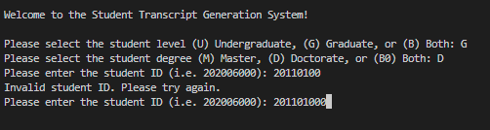
Function: Output
def startFeature():

Slide 7
Functions Used:
def detailsFeature():
It has three parameters (stdID, level, and degree.)
It reads student details from a CSV file using pandas and then filters the data based on the stdID, level, and degree
Using the filtered data it creates a string with the student details like name, stdID, levels, college, and department then writes the output string to a text file and prints it.
Lastly, it prints a message and waits for 3 seconds before redirecting to the menu.

Slide 8
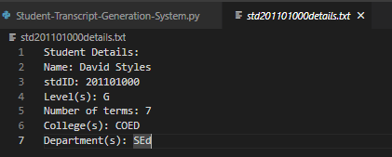
Function: Output
def detailsFeature():

Slide 9
Functions Used:
Def menuFeature():
It displays a menu of options to the user and executes a corresponding function based on the user's choice.
What the menu feature function does:
Display the menu options to the user.
Get the user's choice by asking them to input a number.
Check if the user's choice is a valid integer between 1 and 8.
If the user's choice is valid, execute the corresponding function and record the request.
If the user's choice is not valid, print an error message.

Slide 10
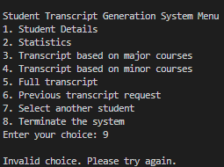
Function: Output
Def menuFeature():

Slide 11
Functions Used:
def statisticsFeature():
This function takes a student ID, a list of levels, and a list of degrees as input, and outputs statistics about the student's grades in their courses.
This function first reads the student's course details from a CSV file and filters the data based on the selected levels and degrees.
Then, the function calculates various statistics, including overall average, term averages, maximum and minimum grades, and the terms in which those grades were achieved.
Lastly, the function formats the statistics into a string and writes it into a text file, which will be printed to the console. If no data is found, the function outputs a message indicating that no data was found then the function waits for 3 seconds before redirecting to the menu features.

Slide 12
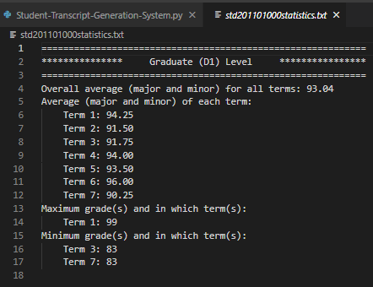
Function: Output
def statisticsFeature():

Slide 13
Functions Used:
def majorTranscriptFeature():
This function loads student data from the two inputted CSV files and filters them according to the 3 arguments in the parameter. Then it computes the major and overall averages for each term and adds them to the output string.
The output string will be written into a text file and then print it on the console.
If the function doesn't find any data for the provided stdID, levels, and degrees, it prints a message indicating that no data was found. Afterward, it redirects the user to the menu and waits for three seconds before returning to the menu.

Slide 14
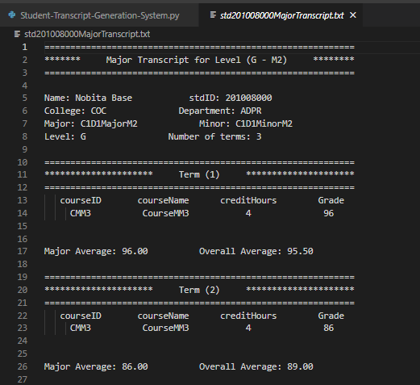
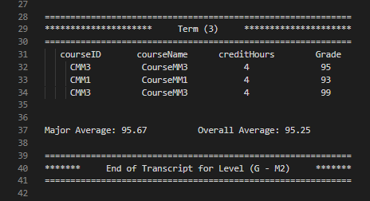
Function: Output
def majorTranscriptFeature():

Slide 15
Functions Used:
def minorTranscriptFeature():
This function takes in three arguments: stdID, levels, and degrees.
It reads data from two CSV files( studentDetails.csv and a file named after the stdID argument)
It filters the data based on the stdID, levels, and degrees arguments and generates a minor transcript for the selected student.
The output is saved in a text file named std{stdID}MinorTranscript.txt and prints the output string in the console.
If no data is found, it prints a message indicating that no data was found. Afterward, it redirects the user to the menu and waits for three seconds before returning to the menu.

Slide 16
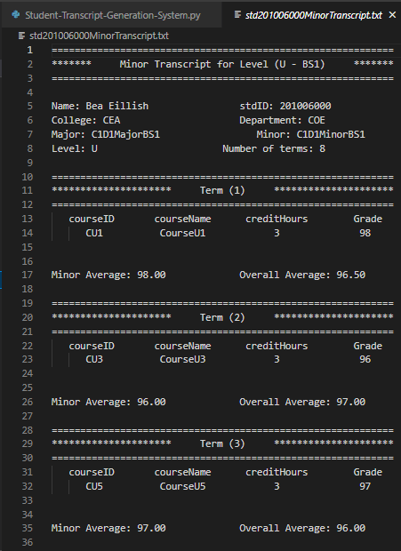
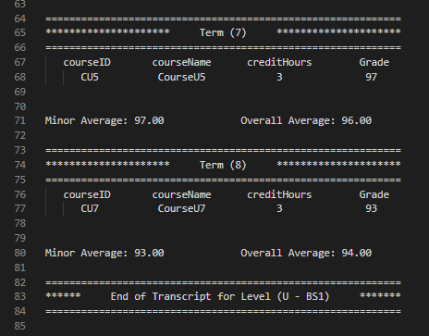
Function: Output
def minorTranscriptFeature():

Slide 17
Functions Used:
def fullTranscriptFeature():
This function generates a full transcript for a given student with the specified levels and degrees
The function first loads the student details and student data into data frames. It then iterates over the selected levels and degrees and filters the data frames for rows matching the given student ID, level, and degree. If matching data is found, the function appends student details, including name, ID, college, department, major, minor, level, and number of terms, to an output string.
For each term, it filters the data frame for rows matching the given term and appends course details, including course ID, course name, credit hours, and average grades for each course in that term, to the output
Lastly, it writes the output string to a TXT file and prints it.

Slide 18
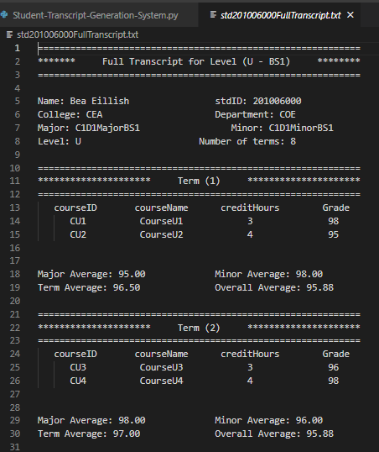
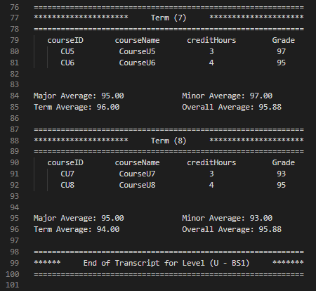
Function: Output
def fullTranscriptFeature():

Slide 19
Functions Used:
def recordRequest():
This function records a request by appending the request type in requestType list, and the current date and time in dateNow and timeNow lists.
It does this by first getting the current date and time using the strftime() method of the datetime modul, then the date is formatted as "day/month/year" using "%d/%m/%Y", and the time is formatted as "hour:minute AM/PM" using "%I:%M %p".
Then it appends the date and time to the dateNow and timeNow lists, respectively.

Slide 20
Functions Used:
def previousRequestsFeature():
This function has a stdID parameter which is used to create a filename for the text file({stdID}previousRequest.txt) that will store the previous requests of the student.
The function appends the request type, time, and date for each request made by the student, and then prints out all the previous requests in the file.
After writing and printing the previous request it waits for 3 seconds before returning to the main menu.

Slide 21
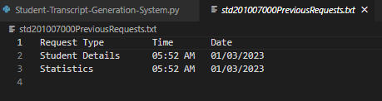
Function: Output
def previousRequestsFeature():

Slide 22
Functions Used:
def printPreviousRequestsFeature():
The function reads the contents of a file named std{stdID}PreviousRequests.txt.
If the file exists, the function displays the previous requests for the specified student ID in the console by iterating over each line in the file and printing it.
If the file does not exist, the function prints a message indicating that no previous requests were recorded.
After displaying the previous requests or the message, the function calls a function clearOutput(), clearing the console.

Slide 23
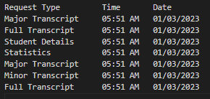
Functions: Output
def printPreviousRequestsFeature():

Slide 24
Functions Used:
def clearOutput():
The function waits for 3 seconds using the time.sleep() method, and then clears the console output by calling a function called clear() that is defined inside it.
The clear() function returns the os.system() method with the argument 'cls', which is a Windows command that clears the console screen.

Slide 25


. . . . . . . . . . . . . . . . . . . . .
. . . . . . . . . .
. . . . . . . . . . . . . . . . . . . . .
. . . . . . . . . .
. . . . . . . . . . . . . . . . . . . . .
. . . . . . . . . .
. . . . . . . . . . . . . . . . . . . . .
. . . . . . . . . .
. . . . . . . . . . . . . . . . . . . . .
. . . . . . . . . .
. . . . . . . . . . . . . . . . . . . . .
. . . . . . . . . .
. . . . . . . . . . . . . . . . . . . . .
. . . . . . . . . .
Live Demo
Live Demo
Live Demo
Live Demo
. . . . . . . . . . . . . . . . . . . . .
. . . . . . . . . .
. . . . . . . . . . . . . . . . . . . . .
. . . . . . . . . .
. . . . . . . . . . . . . . . . . . . . .
. . . . . . . . . .
. . . . . . . . . . . . . . . . . . . . .
. . . . . . . . . .
. . . . . . . . . . . . . . . . . . . . .
. . . . . . . . . .
. . . . . . . . . . . . . . . . . . . . .
. . . . . . . . . .
. . . . . . . . . . . . . . . . . . . . .
. . . . . . . . . .
. . . . . . . . . . . . . . . . . . . . .
. . . . . . . . . .
. . . . . . . . . . . . . . . . . . . . .
. . . . . . . . . .
. . . . . . . . . . . . . . . . . . . . .
. . . . . . . . . .
. . . . . . . . . . . . . . . . . . . . .
. . . . . . . . . .
. . . . . . . . . . . . . . . . . . . . .
. . . . . . . . . .

